Slide 1
AI developer bootcamp: Bots
James Carpinter
CTO, Zarmada | Microsoft Regional Director
james@zarmada.com | @jamescarpinter

Slide 2
How do I build a bot?
How does it understand what my users ask it?
Language
Dynamics 365
Skype
Knowledge
Speech
Browser
Azure Bot Service
Cognitive Services
Vision
Cortana
Web
Azure ML
Cognitive Toolkit

Slide 3
1990s: Internet
Search
User “visits” websites
The future: Conversations
Natural language between people and technology
Conversational canvas
Bots and agents
1980s: PC
Desktop
2000s: Mobile
Social
User download apps from App Stores

Slide 4





Why a bot?
TYPE
TALK
TAP
Bot builder
Cortana
Facebook Messenger
Skype
Platform services
Intelligent tools
Bing

Slide 5
What is a bot?
It’s one thing: it’s an app that performs an automated task
It solves the user’s needs in the quickest/easiest way compared to any other option... like an app, or a website
What makes a bot great:
It is not how much AI it has
It is not how much natural language it offers
It is not whether it uses voice or not

Slide 6


What is a bot?
Platform
Platform services
HTTP
AI
{ Your Code }
Intelligent tools
REST Endpoint
SDK
Bot builder SDK
REST endpoint
Direct Line Protocol
Conversational and business logic
Canvas aware
Context sensitive

Slide 7


Anatomy of a typical bot
Conversation Canvas/Channels
Your bot code goes here
Web Chat
Bot Connector Service
Email
Message input <> output
State Management
Facebook
Bot web service
Bot Builder SDK
GroupMe
Your bot code
Kik
Skype
Bot Builder SDK
API, SDK calls
Slack
+ Microsoft Cognitive Services
Telegram
Other services, APIs,
Databases, Azure Machine Learning, Azure Search, etc…
Natural Language
Translation
Vision/Face
Emotion
Twilio (SMS)
…
Direct Line
Speech
Entity Extraction
Search
Knowledge API
…
…
…

Slide 8





Your Bot Framework Bot
Bot Builder
Developer Portal
Cognitive Services
Tools and services
Connect your bots
AI services to add intelligence
Open source
From prompts & dialogs to form flows
Rich attachments
Online/offline chat emulator
Add bot smarts for language understanding
Register, connect, publish and manage your bot
Automatic card normalization
Embeddable Web chat
Direct Line API
Bot Directory
Parse natural language
Real-time transcription and translation services for voice
Vision and face detection algorithms
Sentence diagramming
Web language parsing

Slide 9
A Bare Minimum Bot Code – C#
[ResponseType(typeof(void))]
public virtual async Task<HttpResponseMessage> Post([FromBody] Activity activity)
{
if (activity != null)
{
switch (activity.GetActivityType())
{
case ActivityTypes.Message:
IConversationUpdateActivity message = activity;
using (var scope = DialogModule.BeginLifetimeScope(Conversation.Container, activity))
{
var client = scope.Resolve<IConnectorClient>();
var reply = activity.CreateReply();
reply.Text = "You said: " + message.Text;
await client.Conversations.ReplyToActivityAsync(reply);
}
}
}
}

Slide 10
Bot Connector message
Your bot
Bot Connector
"type" : "message" ,
"id" : 68YrxgtB53Y" ,
"conversationId" : "DphpaFQrDuZDKyCez4AFGcT4vy5aQDjellLGIjB8v18MFtb",
"language" : "en" ,
"text" : "You can say \ "/ order\" to order!",
"attachments" : [ ],
"from" : {
"name" : "+12065551212",
"channelId" : "sms",
"address" : " +12065551212",
"id" : "Ro52hKN287",
"isBot" : false
},
"channelData" : { SMS data here },
…

Slide 11
Hosting
Abstraction of servers
Event-driven/ instant scale
Micro-billing
Reduced DevOps
Focus on business logic
Faster time to market

Slide 12


Hosting
Code
Azure Functions
Events + data

Slide 13





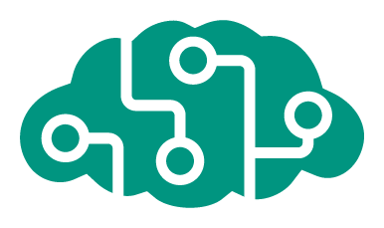







Azure Bot Service
Accelerate development
Enrich your bots
Operational efficiencies
</>
Powered by Azure Functions
Continuous deployment
Develop your way
Built in code editor
Channel support
Cognitive Services
API
Quick start templates
Integrated chat window
Direct Line support
Embedded web chat
Scale on demand
Reduced dev ops

Slide 14
Demo
Creating a new bot

Slide 15
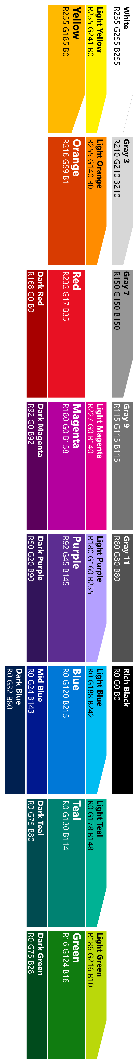
Modelling your conversation
Roll your own
state management etc.
Multi layered conversations
Bespoke
Dialogs
Data capture,
“Web forms” scenarios
Flexibility
FormFlow
FAQs,
command & control
QnA
Effort to implement

Slide 16
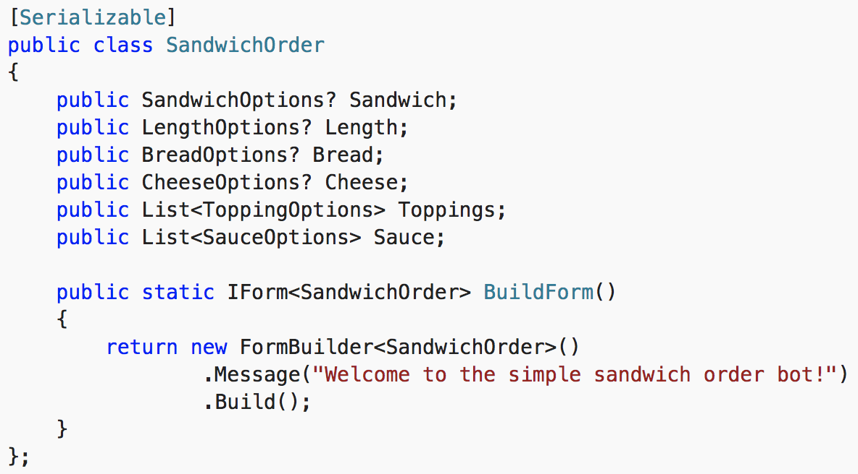
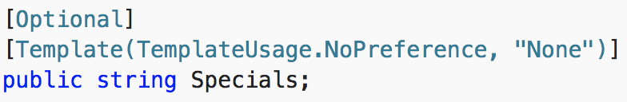
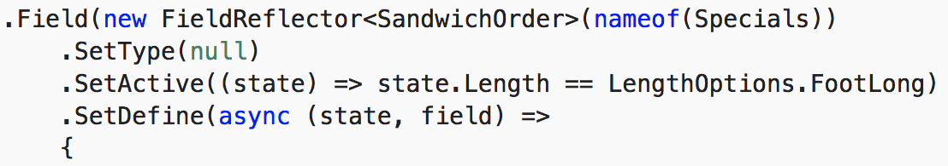
Forms are data binding for bots
Best approach for guided interactions
Define a serializable model
SDK handles collecting, binding, and flow operations (like quit)
Extended via declarative attributes or via code

Slide 17
Modelling your conversation
Roll your own
state management etc.
Multi layered conversations
Bespoke
Dialogs
Data capture,
“Web forms” scenarios
Flexibility
FormFlow
FAQs,
command & control
QnA
Effort to implement

Slide 18
Dialogs are for bots like screens are for apps
They separate concerns and organize flows, exactly the same way:
Traditional Application
Bot
Main Screen
Root Dialog
New Order Screen
Product Search Screen
New Order Dialog
Product Search Dialog

Slide 19
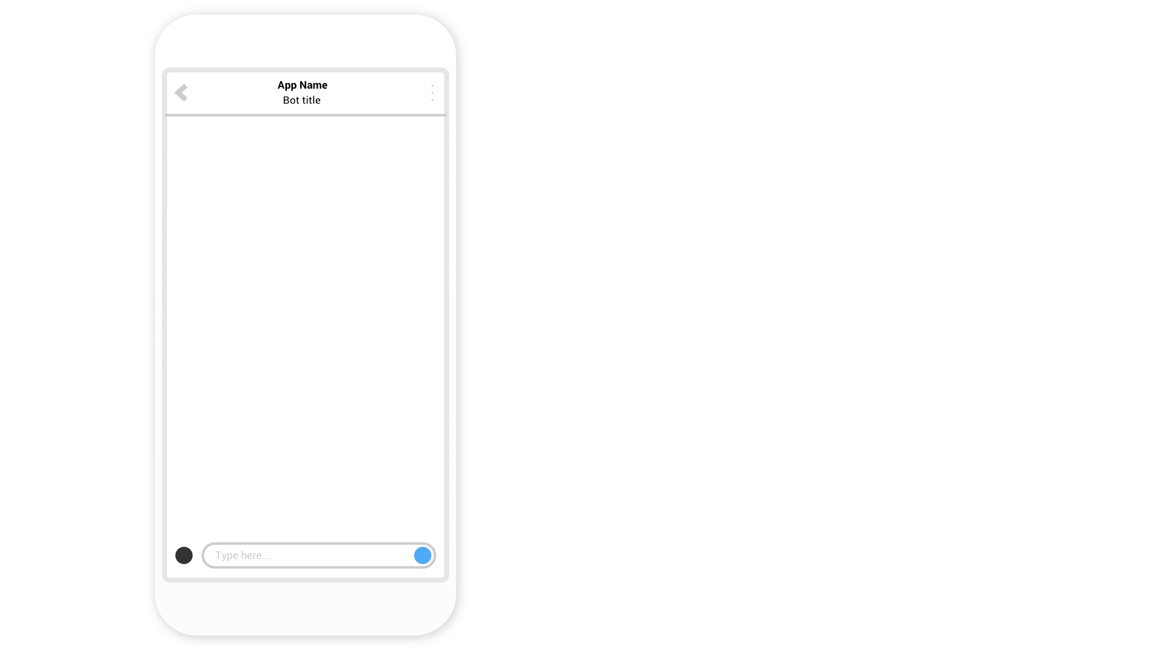

Slide 21


Slide 22
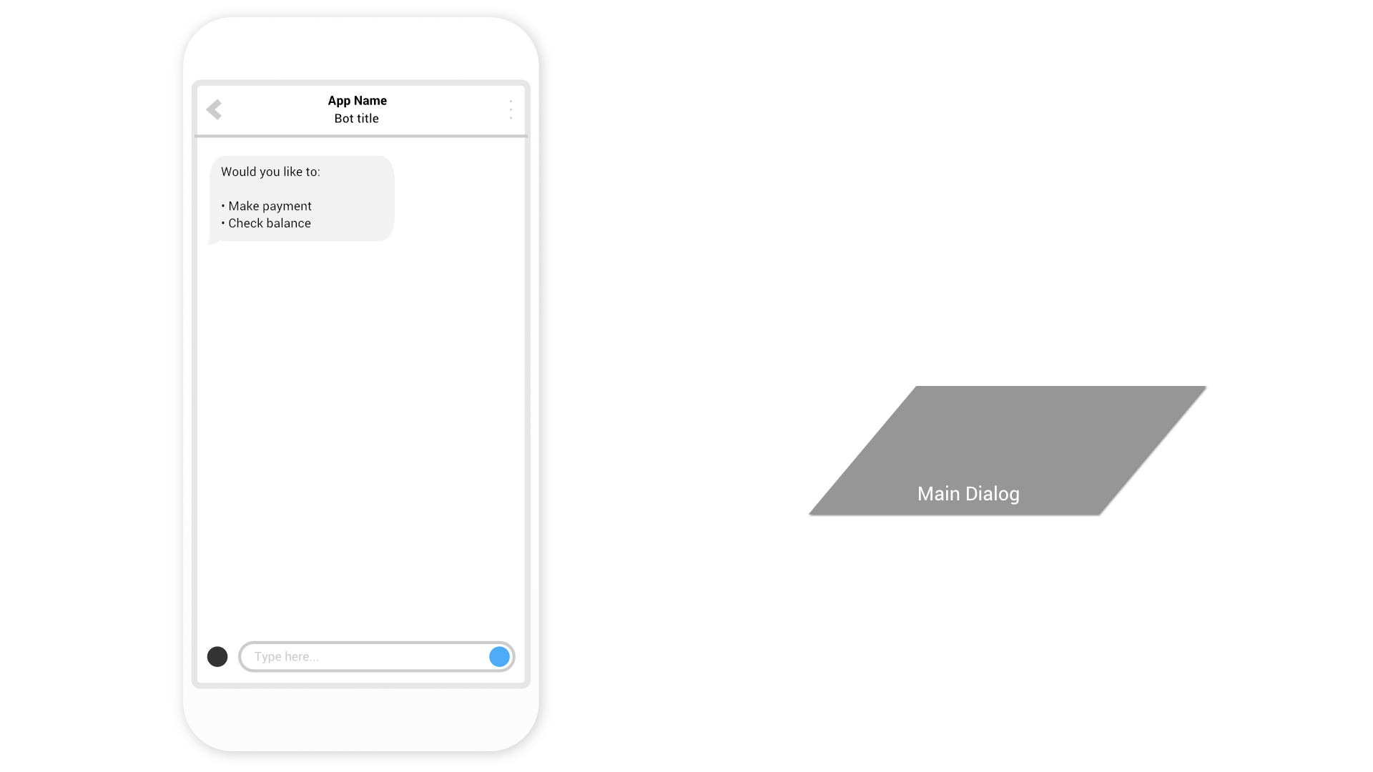

Slide 23
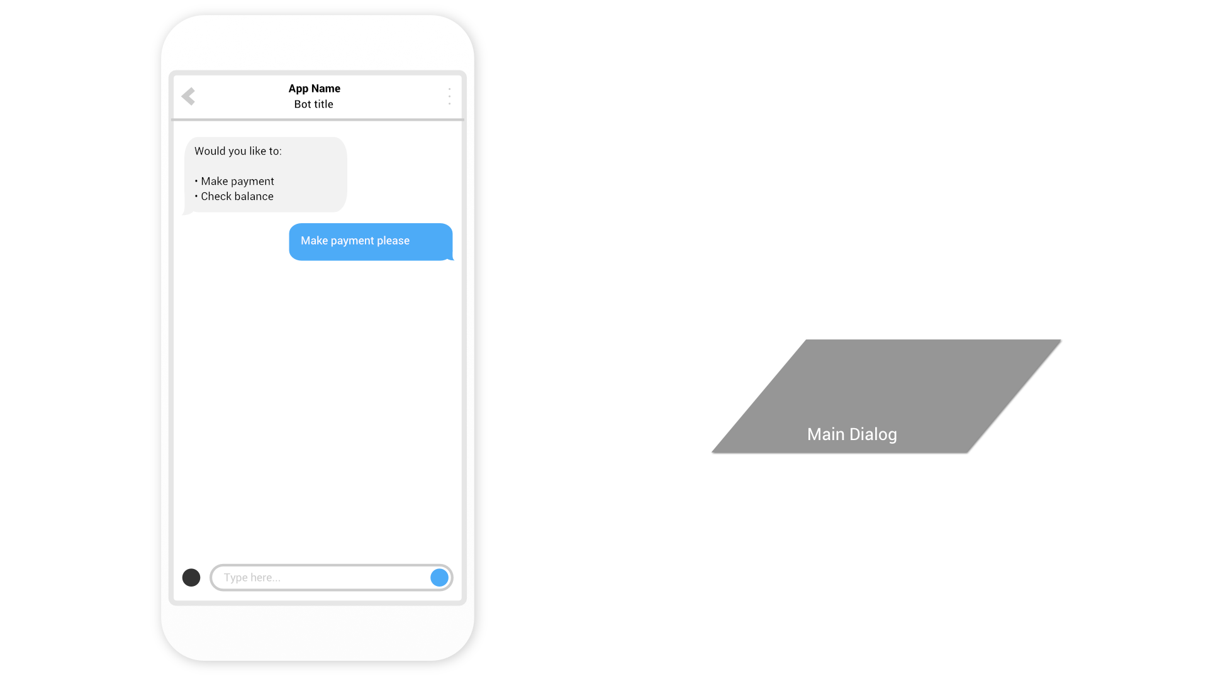

Slide 24
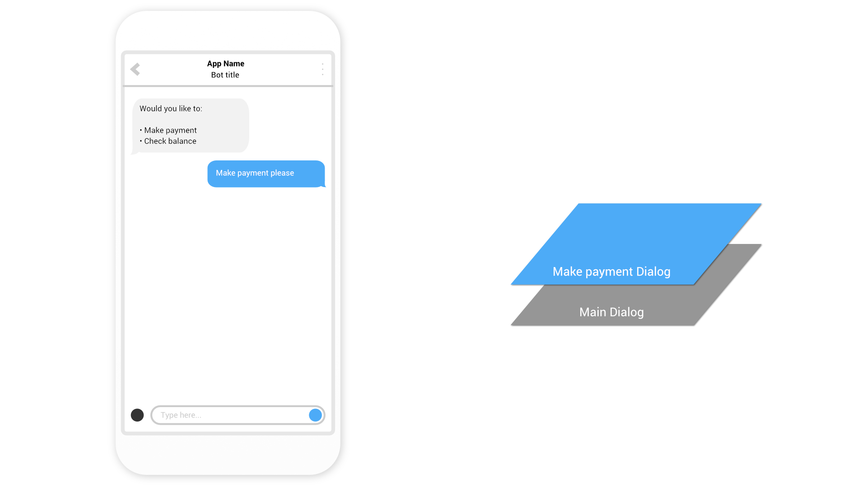

Slide 25


Slide 26
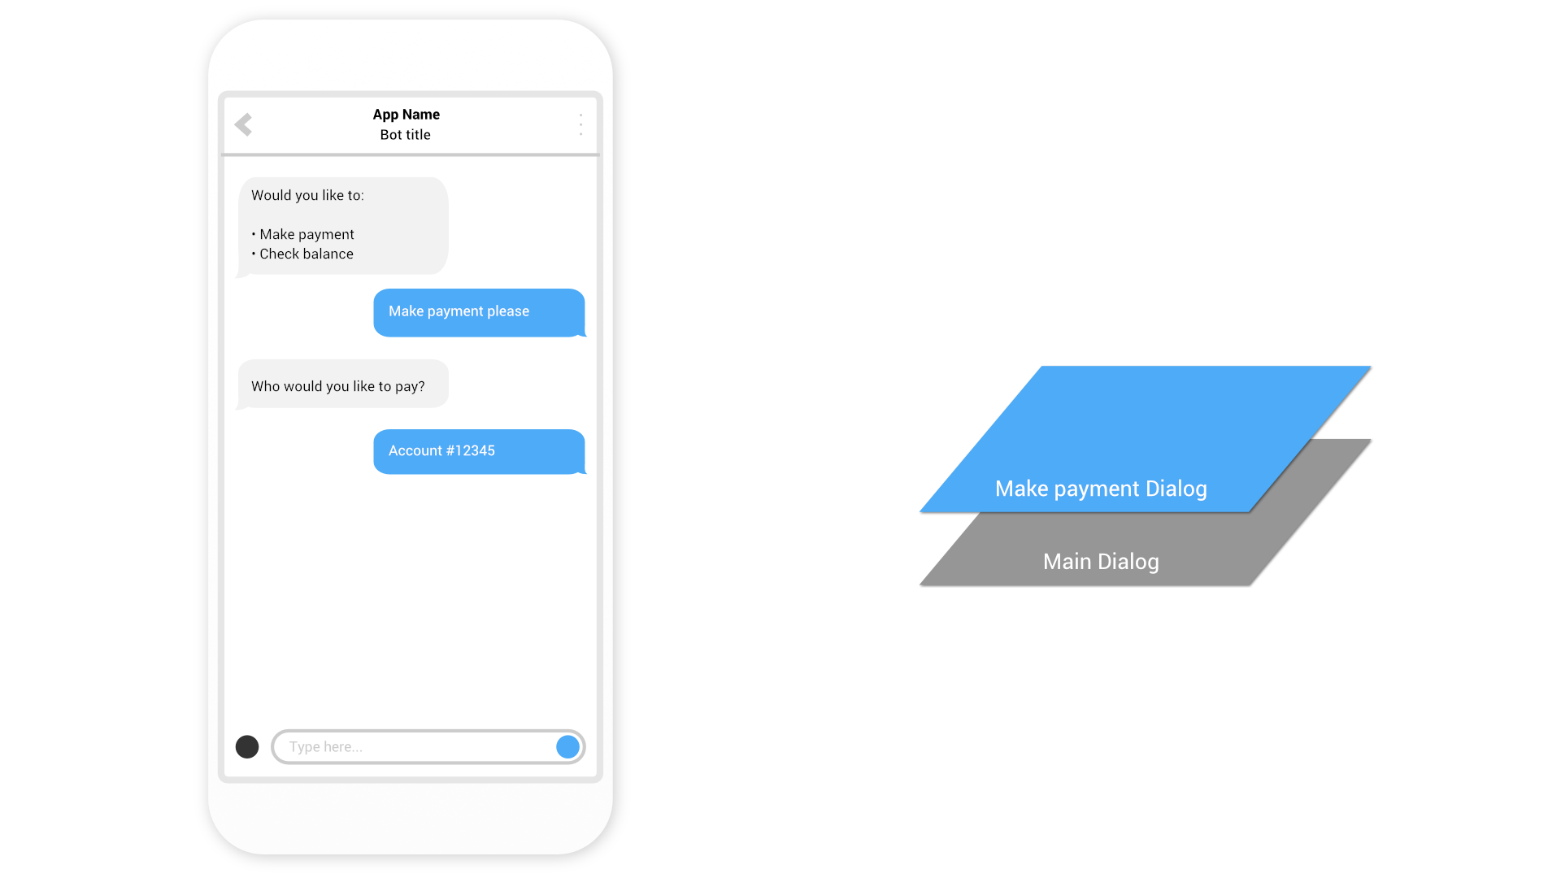

Slide 27


Slide 28
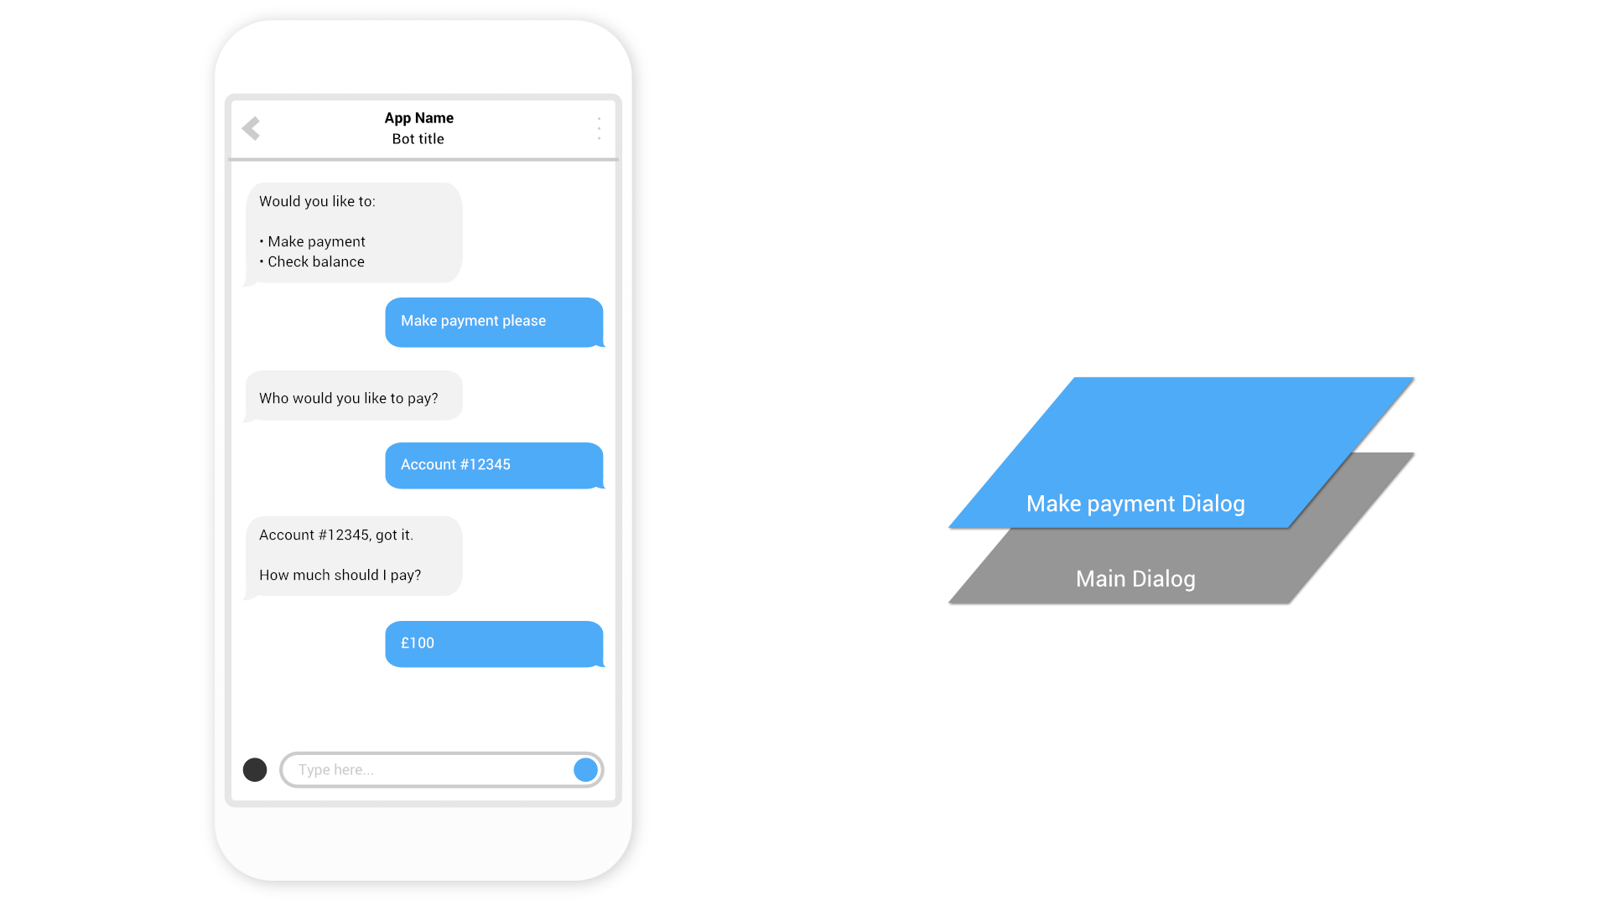

Slide 29
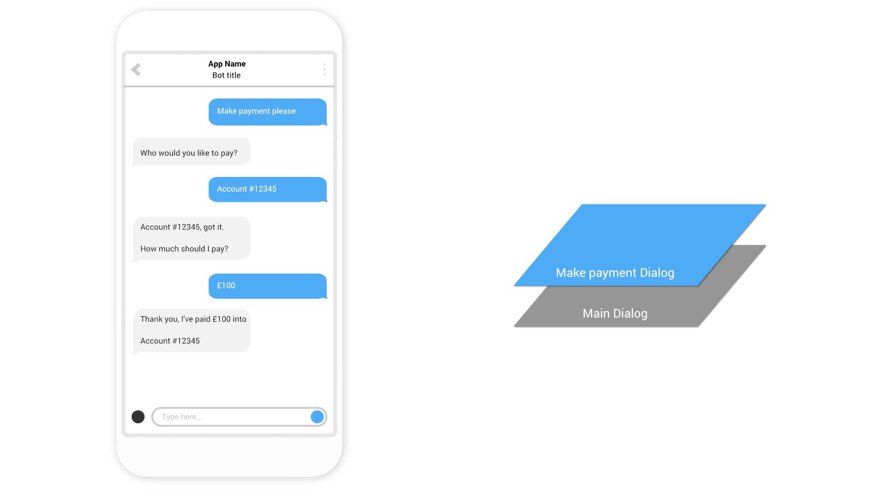

Slide 30
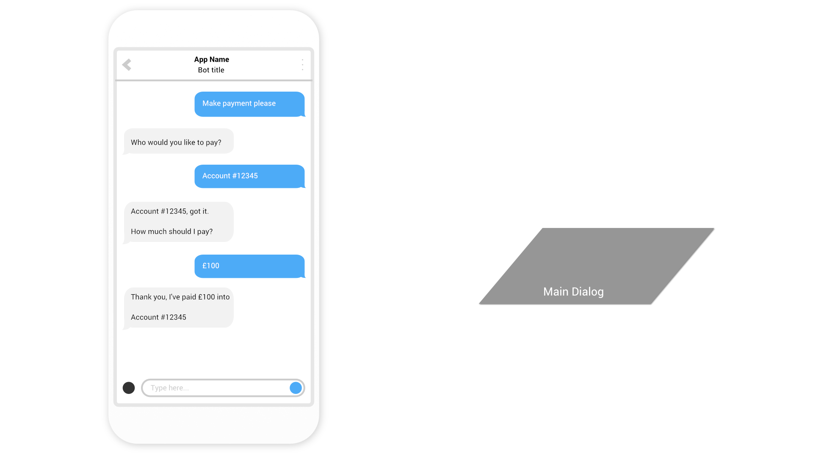

Slide 31
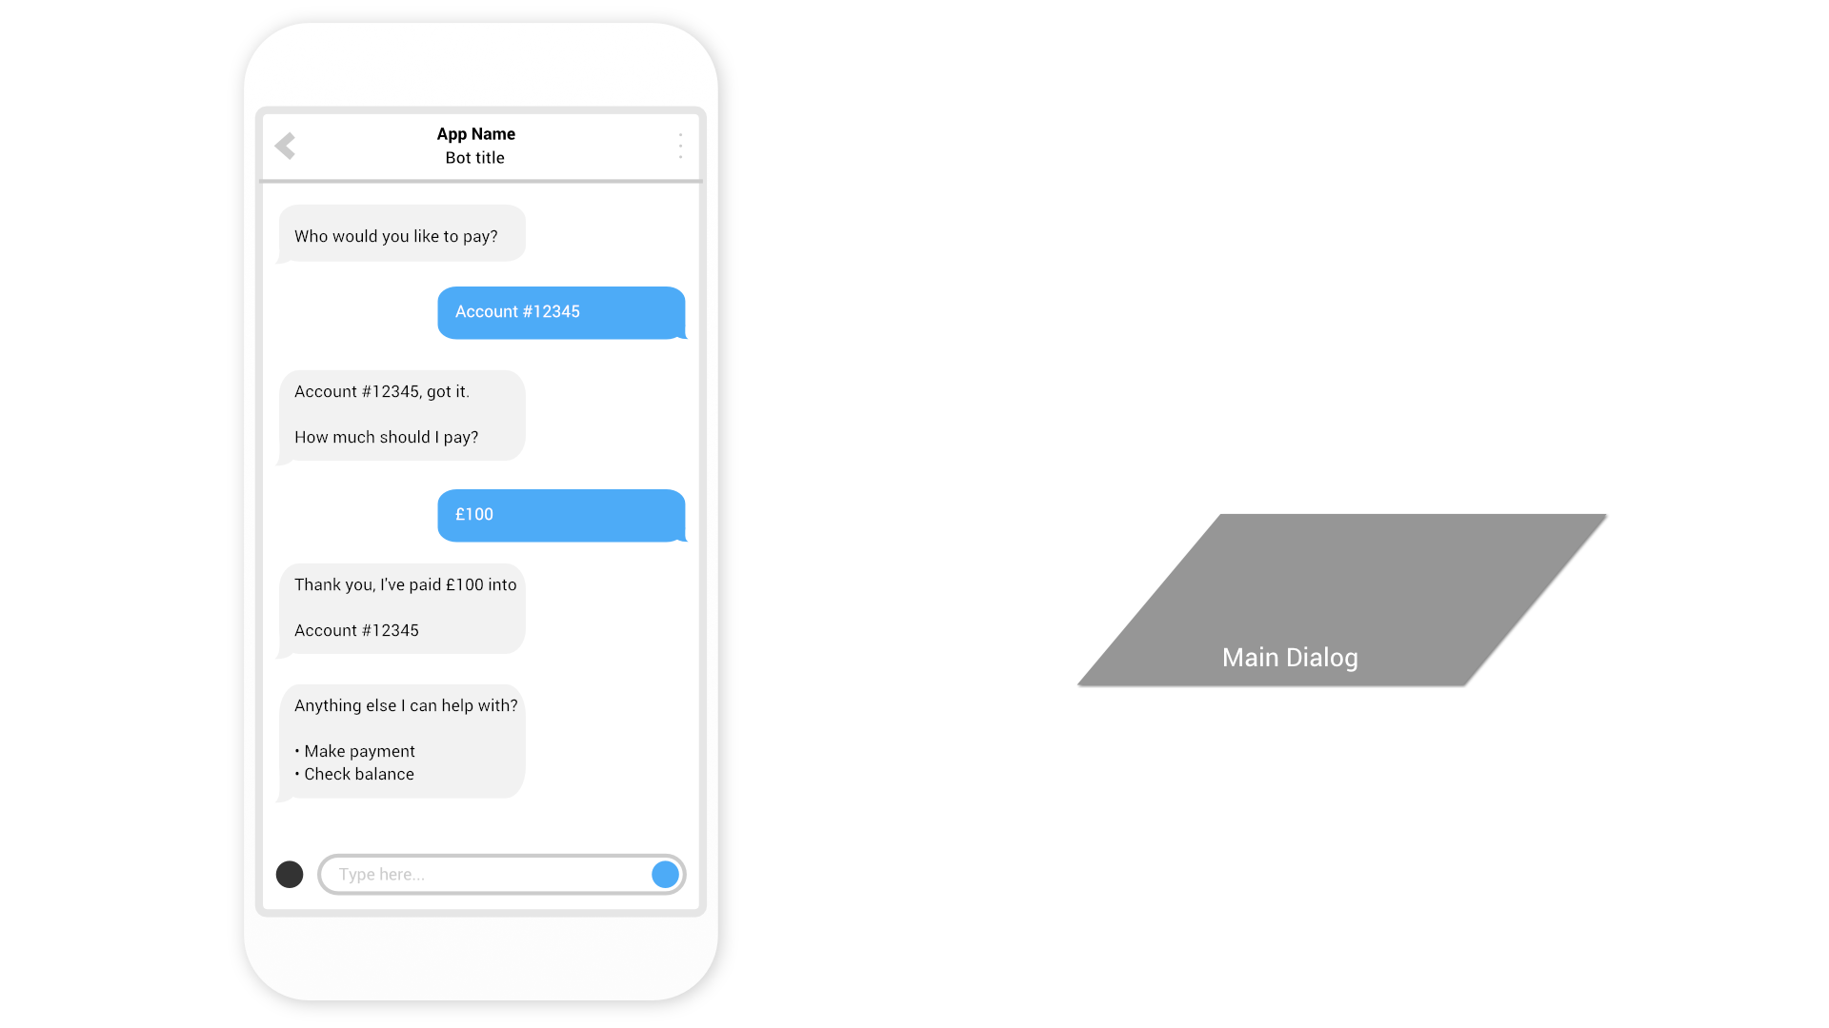

Slide 32
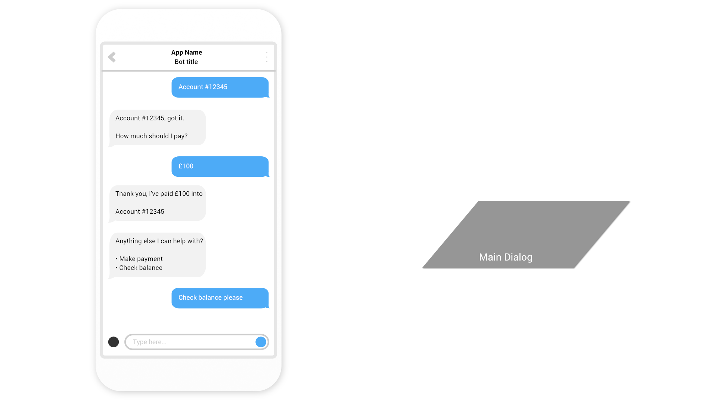

Slide 33
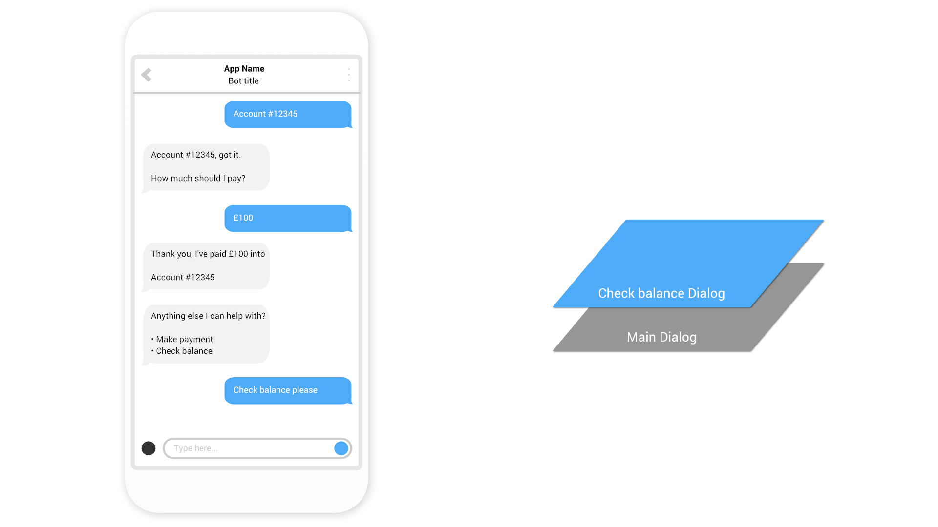
This is how we know how to navigate “back” but users won’t necessarily think that way
So be careful with too much “modality”: things can get complex quickly…

Slide 34
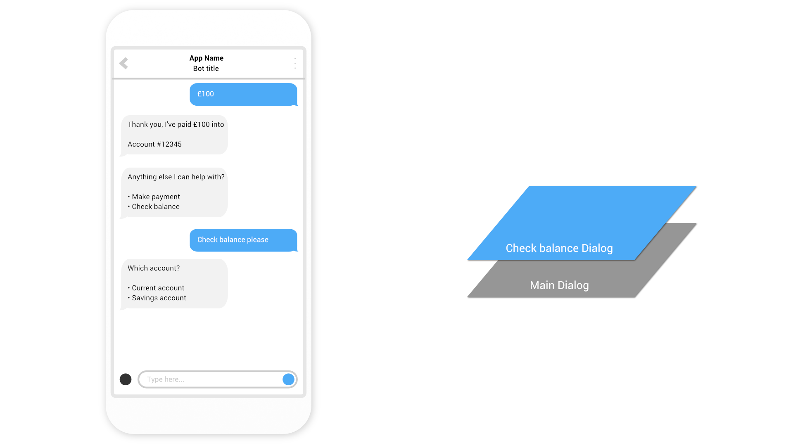

Slide 35
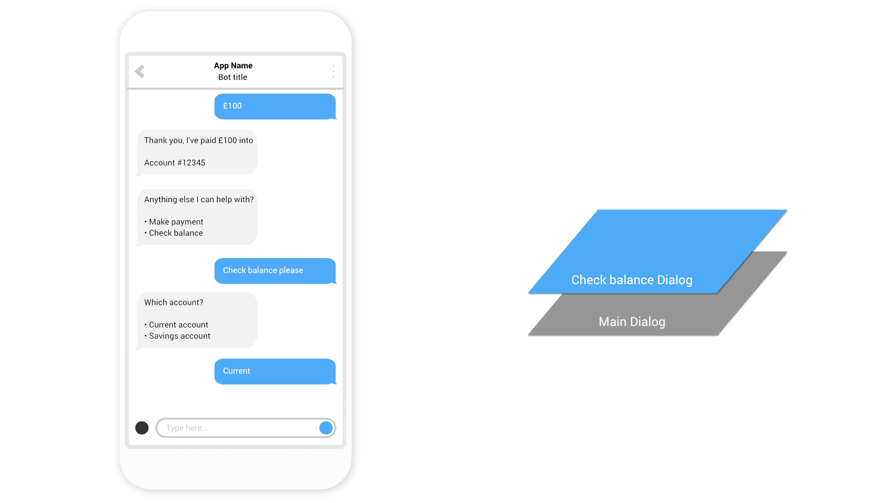

Slide 36
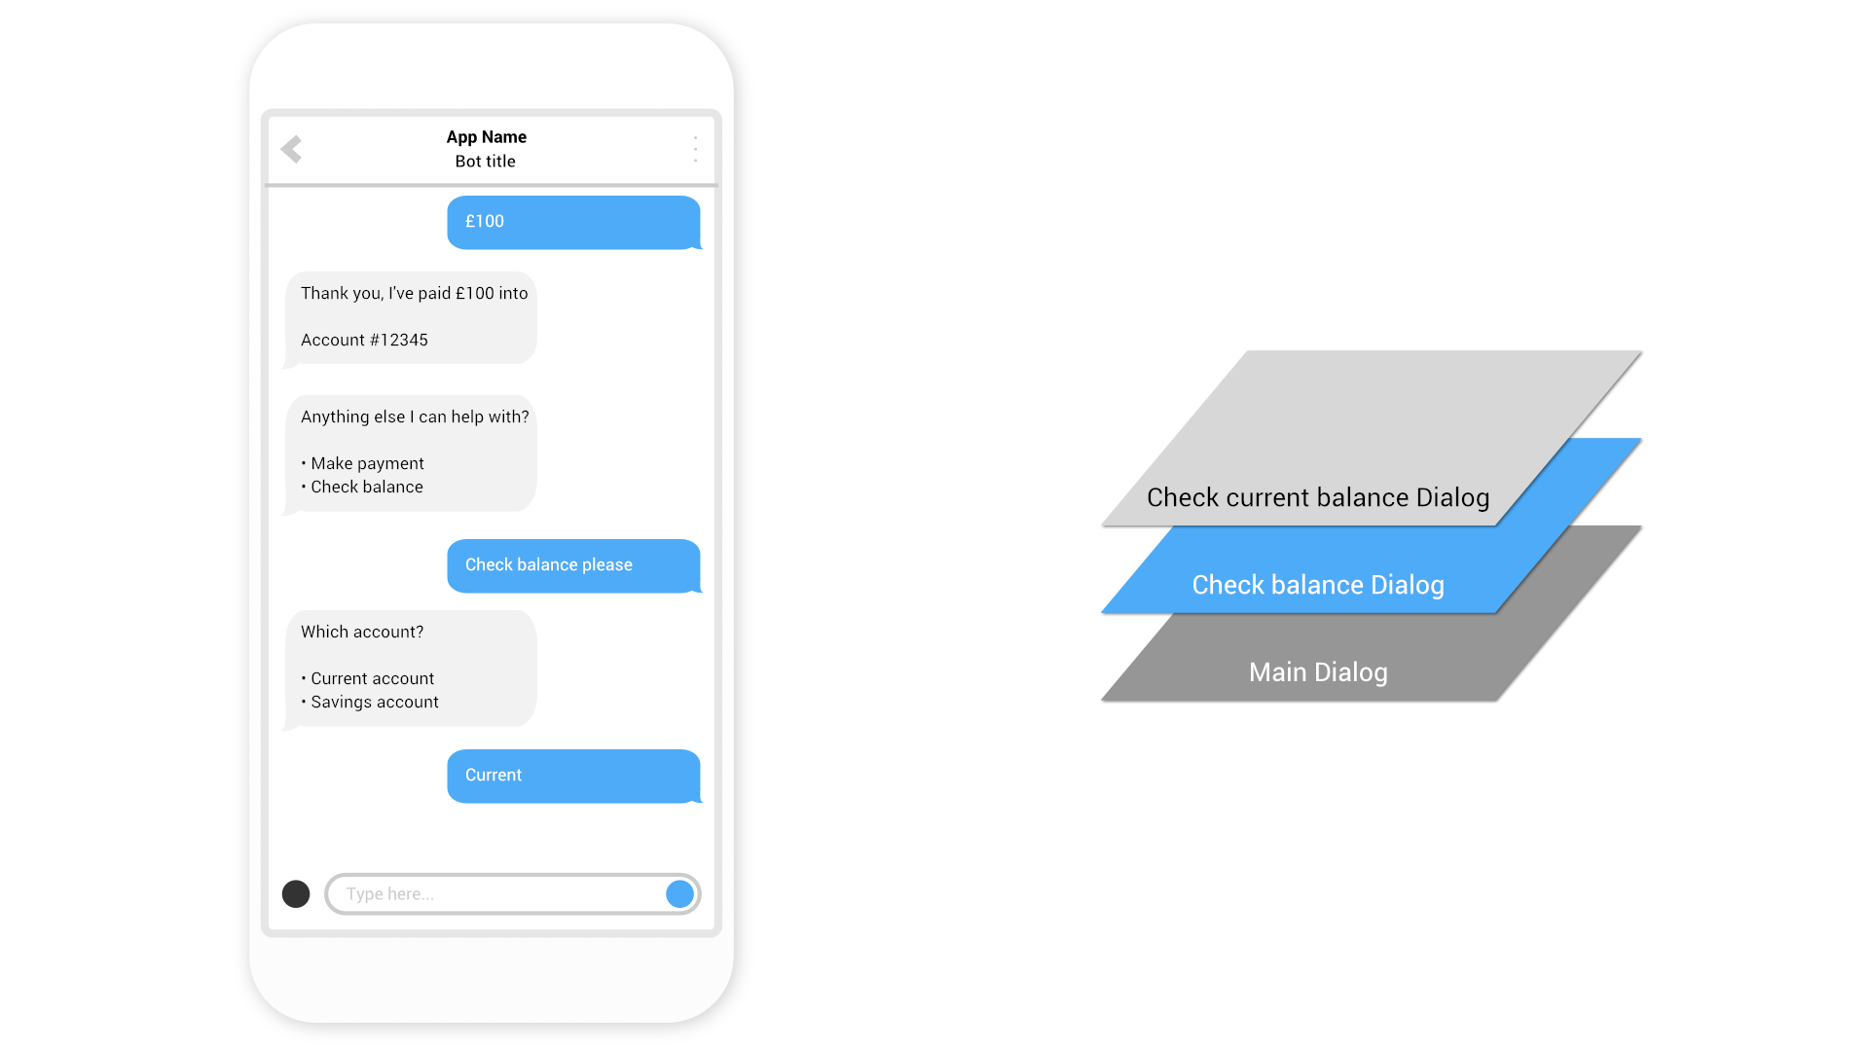

Slide 37
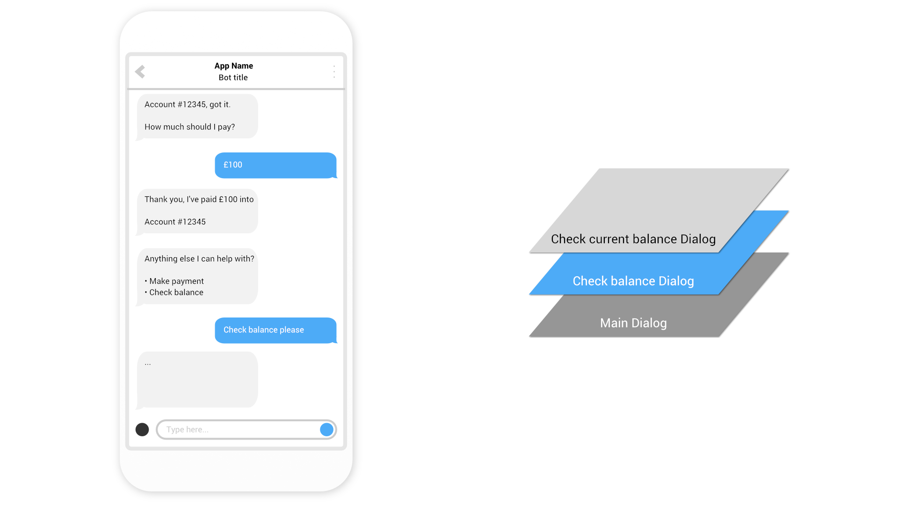

Slide 38
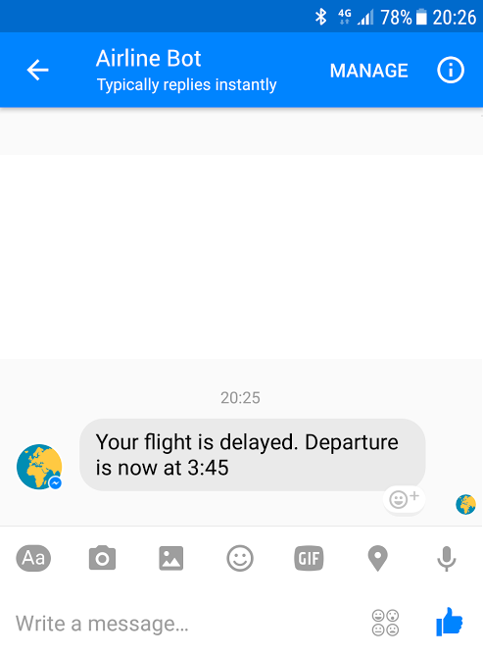
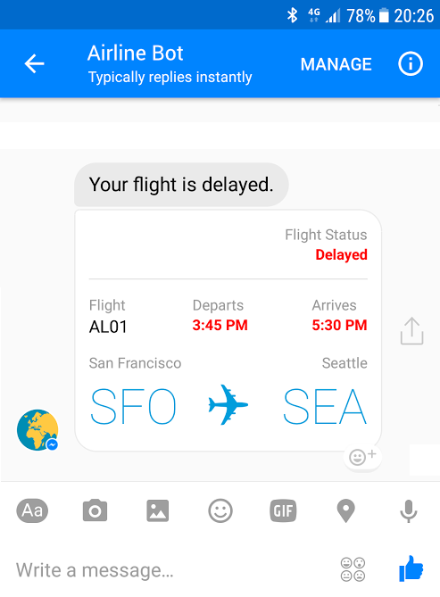
Conversational mechanisms

Slide 39
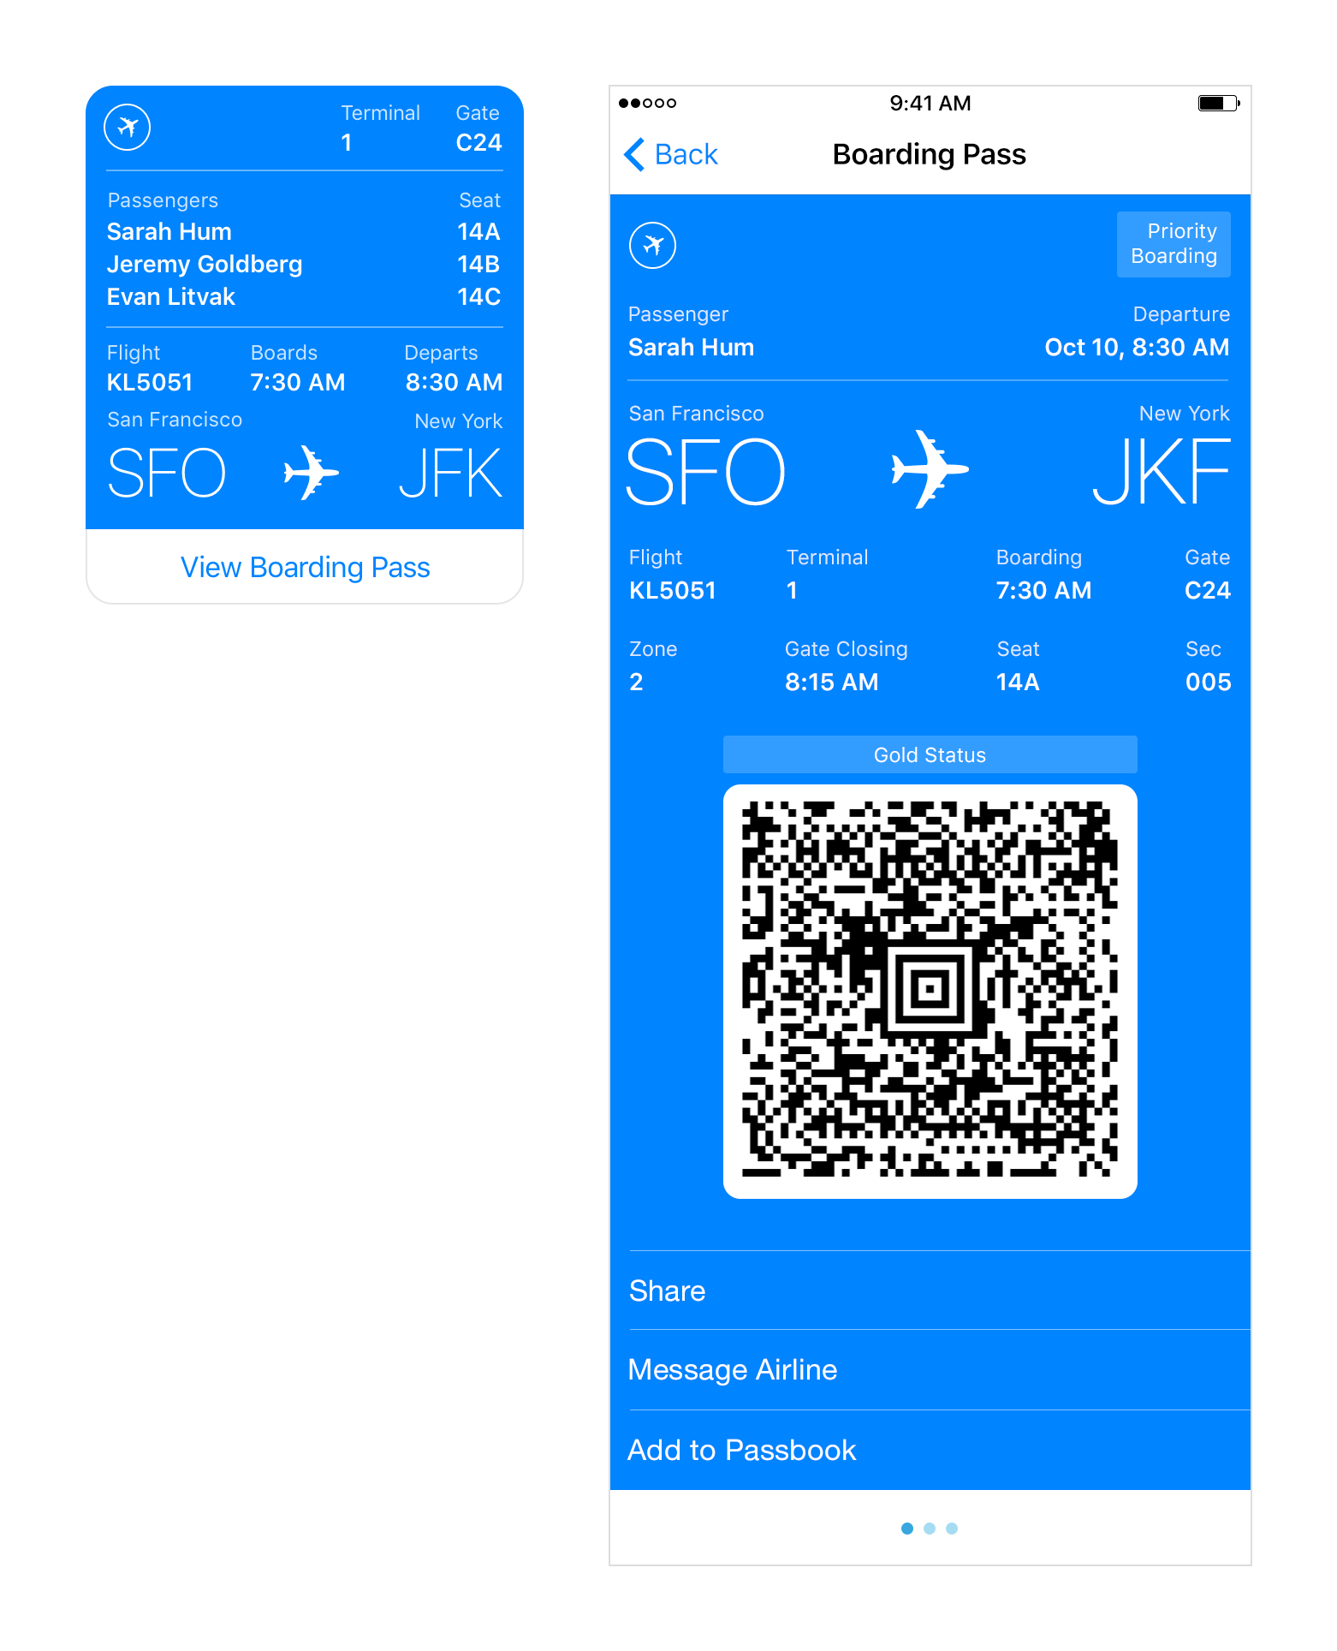
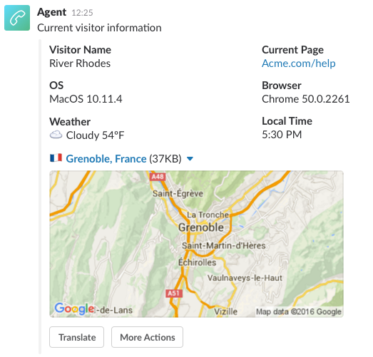
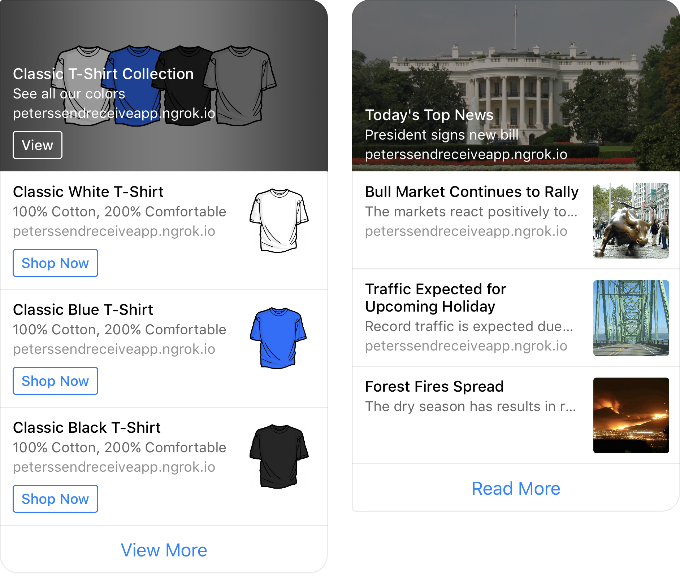
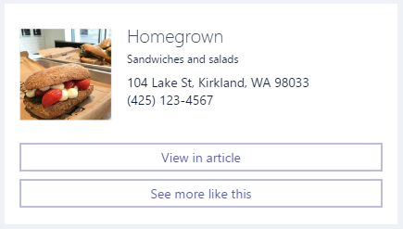
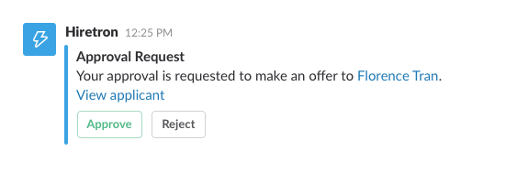
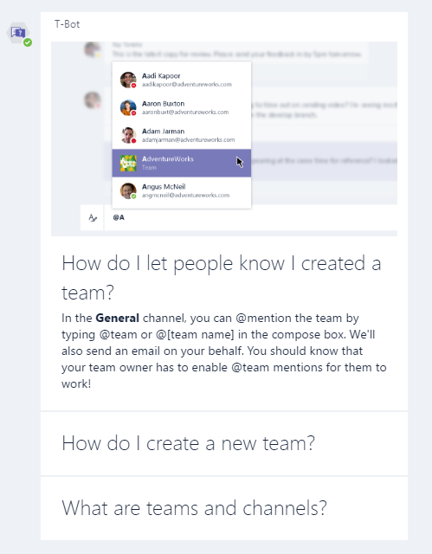
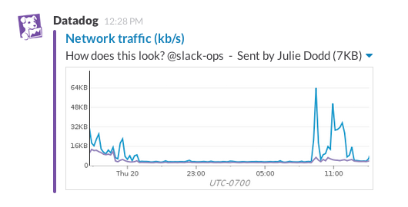
Generic
Channel specific
Adaptive

Slide 40

Conversational mechanisms
Text, with optional media attachments
Traditional chat, can contain media attachments (e.g., image, video, audio, file)
Input prompts
Suggested actions: Buttons, numbered items in a list, etc.
Rich cards, rendered as a list or carousel
Images, buttons, audio, animations, video, user sign-in, etc.
Hero | Audio | Animation | Thumbnail | Receipt | Sign In | Video | Adaptive | Purchase
Speech
Text-based chat using Speech Recognition & Synthesis (TTS)

Slide 41
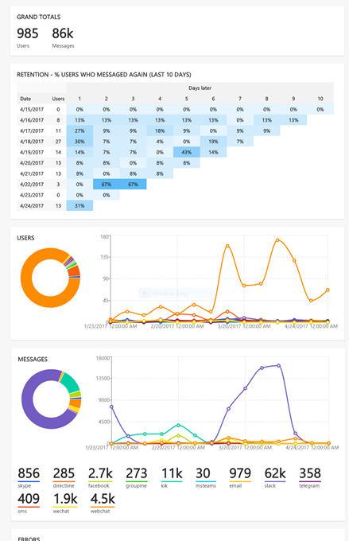
Continuous Improvement
Instrumentation provided by App Insights; added by default in Bot Service
Extend instrumentation through AI SDK
If you are not building bots that will actually be used, then you are not building bots

Slide 42
Demo
Extending our bot with dialogs

Slide 43
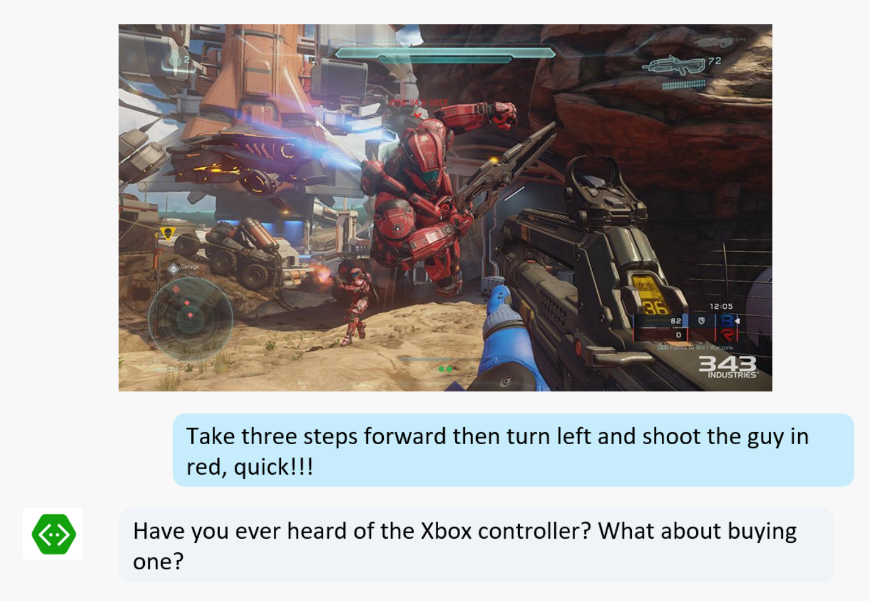
Patterns
Anti-pattern: canvas mismatch
Anti-pattern: overuse of NLP
“I want to find a house for sale that has 3 or 4 bedrooms, priced between $300 and $350 with a large garden, about 2000 square feet, preferably green, within 10 miles from my work which is in the city center, with a large garage and a backyard with a pool.”
-- Said nobody, ever
“I want to find a house”
-- Said everybody else
Hello user! How can I help you?
What events are you interested in?
Events
Music
Stages
Comedy

Slide 44
Patterns
Pattern: Backchannel
Communicate click stream/user behaviors to bot
Have bot communicate changes to be made to the host
Pass auth tokens back and forth
Pattern: Global handlers
People don’t communicate in “stacks”: they change topics all the time
Handling modality can be very difficult
E.g. at any point, the user can say “Help”
Dialog
Web Bot
Bot Connector
Bot
Activity
IScorable
Dialog
Web App
Web API
Dialog

Slide 45

Patterns
Pattern: Handoff to human
Every company deals with this:
I’ve tried these steps, my computer still won’t turn on
Thank you for providing all this information. I have John with me now who will take from here and help you out
Note to operator: It sounds like the user will need hardware replacement, what next step should I take?
Hello, this is John. I understand your computer won’t power on. Let’s take a look at some service options
Customer call
First triage/data collection
Apologize to user
Suggest hardware service
Let me type
I suggest us to request a hardware service. We can have one of our service engineers look at your computer
Simple and repetitive solutions
Complex cases and escalation
Sounds lovely, thank you

Slide 46
Natural language
Language understanding in human-computer interaction is:
Technically challenging
Costly
to implement
Often
domain specific
It’s exceedingly difficult to enable a computer to understand what a person wants and to find the pieces of information that are relevant to their intent.
Building and maintaining machine learning systems requires a large investment of time, money and engineering resources
In the past, building your own machine learned models often required assistance of a team of data scientists that would customize the models to the specific domain.

Slide 47
Language Understanding Intelligent Service
Train by providing examples
Create your own LU model
Deploy to an HTTP endpoint
Maintain model with ease

Slide 48
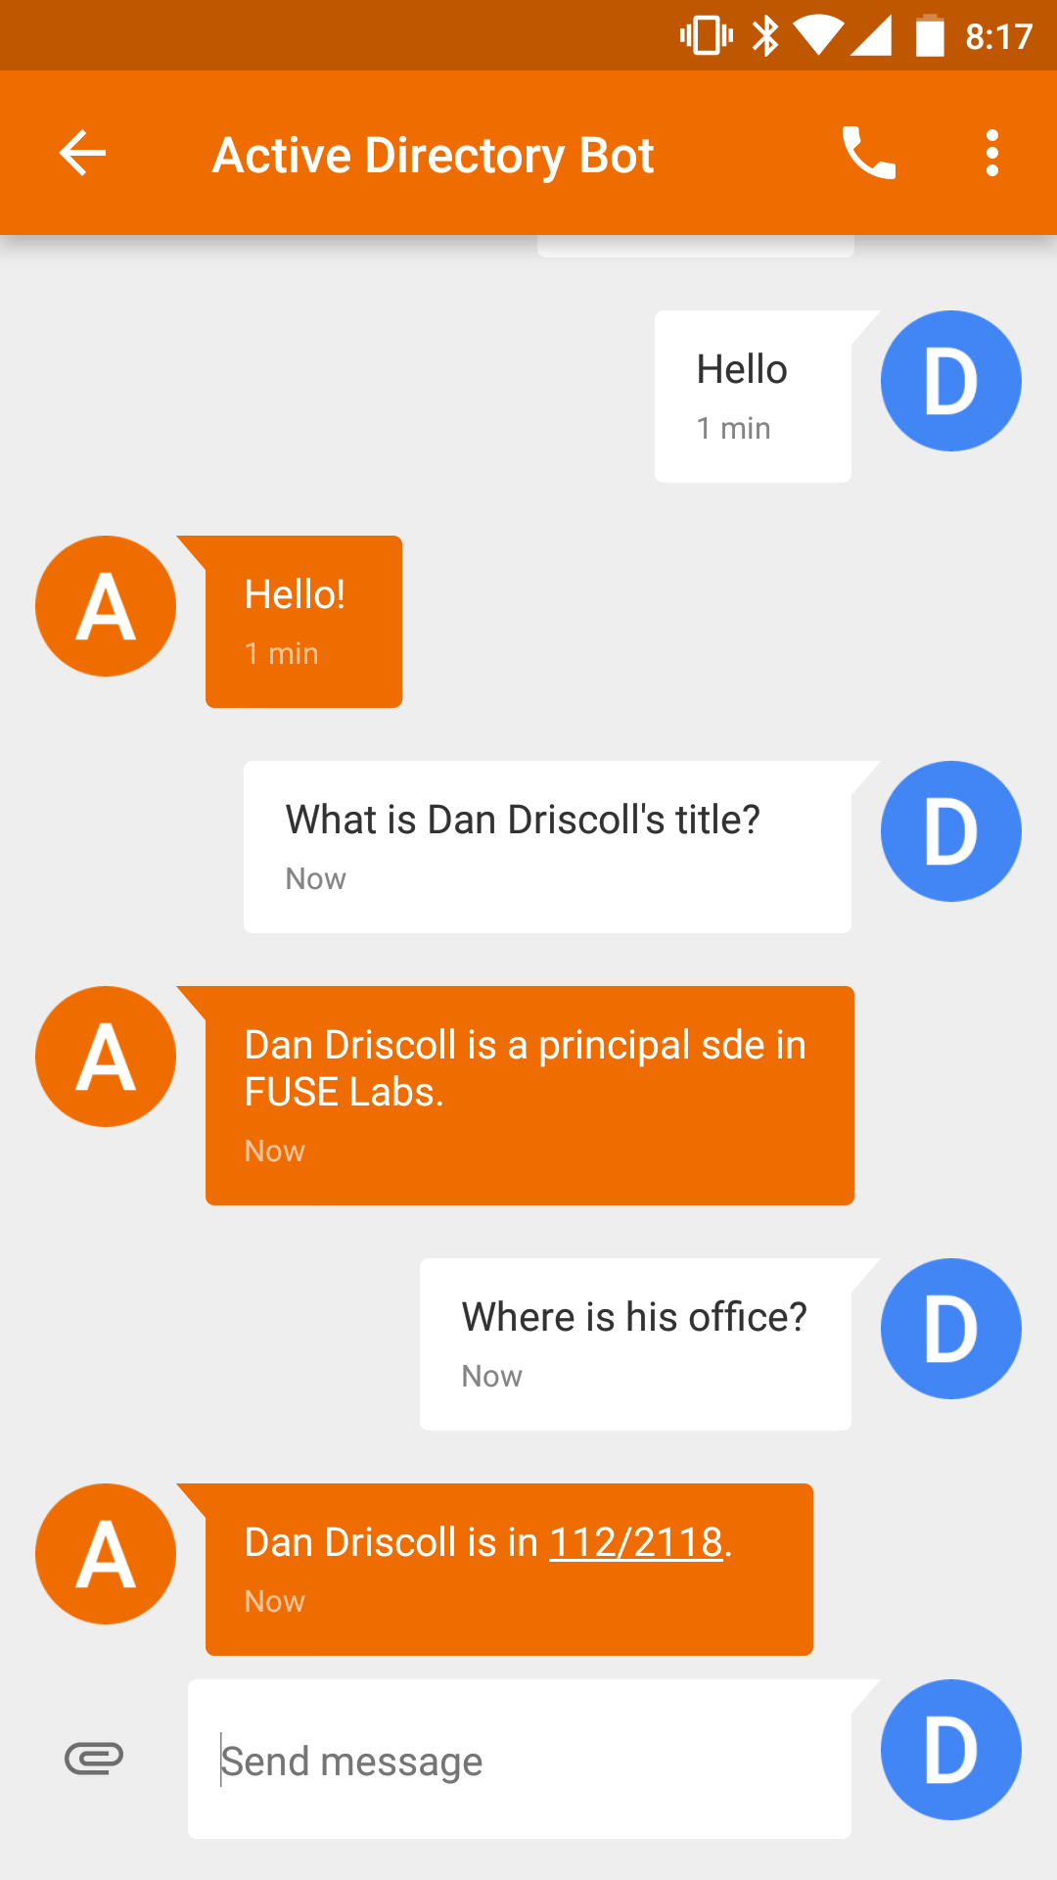
LUIS: Intents & Entities
John
Sue
Erika
Who is _____?
Where does ____ work?
What is _____’s phone number?
Examples of intent detection
Examples of entity extraction

Slide 49
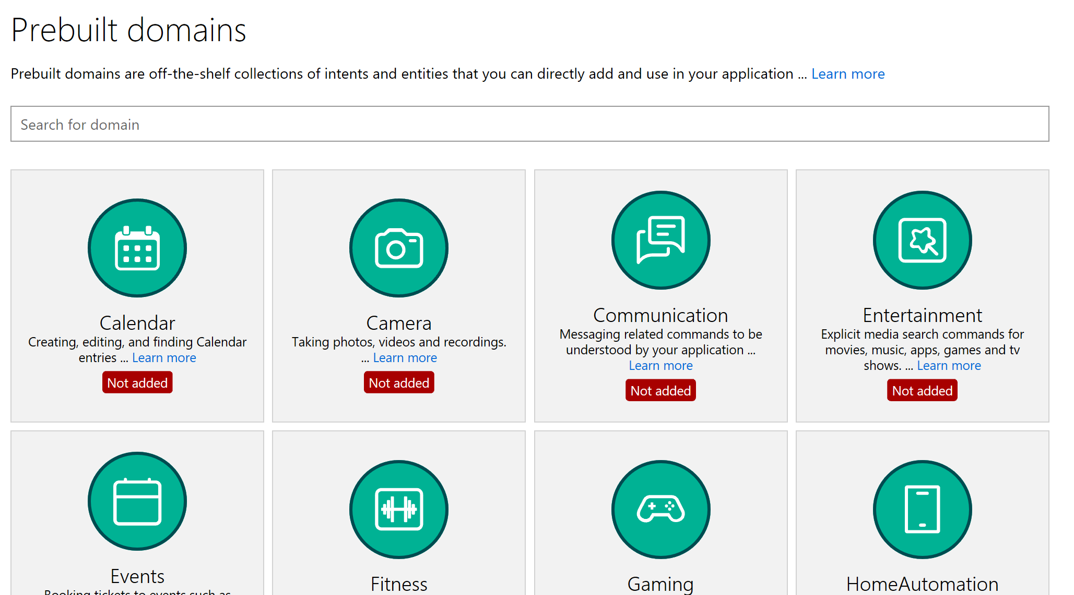
LUIS: Quick Start
Kick start your language model construction through modifiable 20 pre-built domains
Adds Intents, Entities, Utterances
Improved number, unit, money and date/times (e.g. “From May 1st to May 5th”)
Supports English, French, Dutch, Spanish, Italian, German, Korean, Portuguese, Japanese, Chinese
Age
Dimension
Email
Encyclopedia
Geography
Money
Number
Ordinal
Percentage
Phonenumber (US)
Temperature
Url

Slide 50
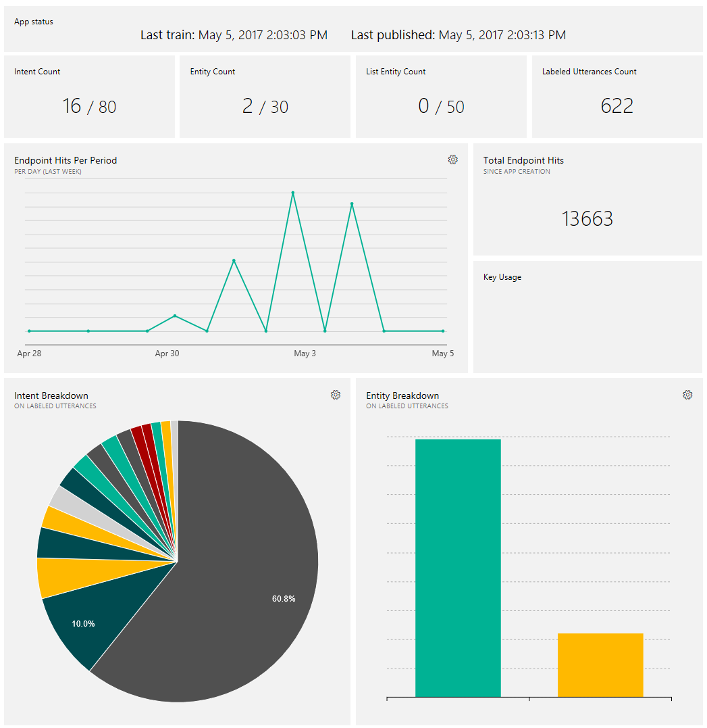
LUIS: Continuous Improvement
Endpoint hits over time
Intent breakdown
Entity breakdown
Misses & suggested intents
Supports export & import
Define
concepts
Provide
examples
Deploy
Active learning

Slide 51
Demo
LUIS in action

Slide 52
How do I build a bot?
Azure Bot Service (which includes Bot Framework)
How does it understand what my users ask it?
LUIS
Language
Dynamics 365
Skype
Knowledge
Speech
Browser
Azure Bot Service
Cognitive Services
Vision
Cortana
Web
Azure ML
Cognitive Toolkit

